Slide 1
1.6.5 The absolute value of a complex number

Slide 2
Introduction
In this topic, we will
Define the absolute value of a complex number
Consider at a few properties
We will prove these properties (or theorems) rigorously

Slide 3
The absolute value
For a real number x,
|x| is the absolute value or magnitude of that value
Some properties of the absolute value include:
|x| ≥ 0
|x| = 0 if and only if x = 0
|xy| = |x||y|
Is there an absolute value of a complex number?

Slide 4
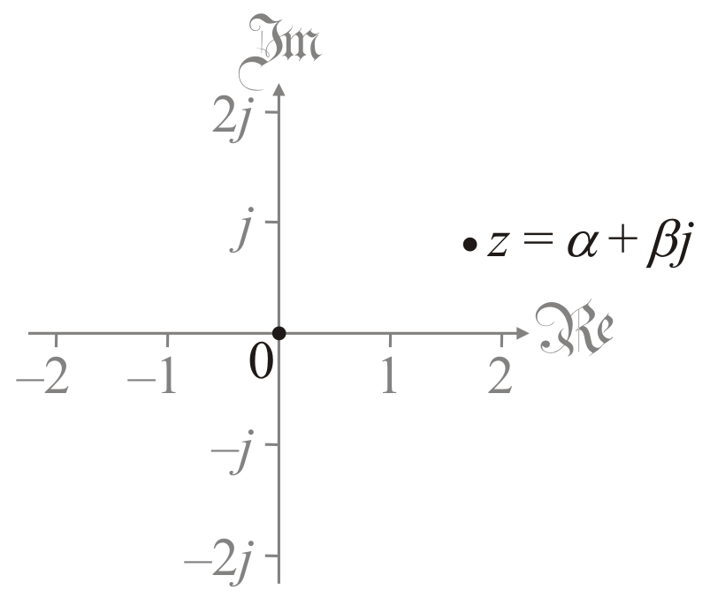
The absolute value
Consider the geometric interpretation of the complex number
α + β j

Slide 5
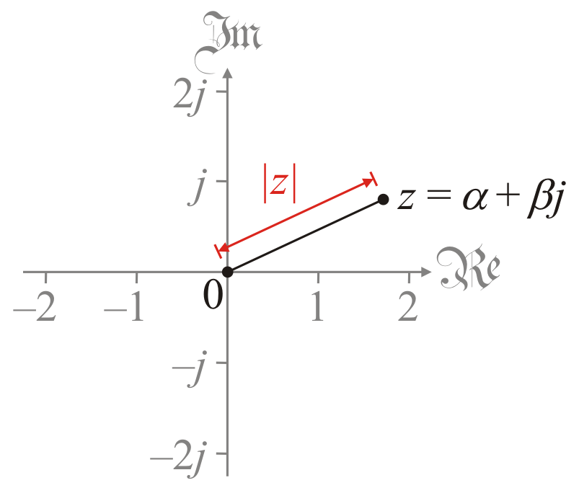
The absolute value
Given this interpretation, we will use the distance to 0
For z = α + β j,
Important: is the real number β and not β j

Slide 6
The absolute value
For example,
If z₁ = 3 + 4 j, then
If z₂ = –2.4 – 0.7 j, then
For any real θ, if z₃ = cos(θ ) + sin(θ ) j, then
If z₄ = 0.1931398164 – 0.02242417046j, then

Slide 7
Absolute value of a real
Theorem: If z is real, then .
Note, this says that the absolute value of a real complex number has the same value of the absolute value of the real part
Proof:
If z is real, then , so z = α + 0j where .
Thus,
.
QED

Slide 8
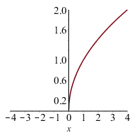
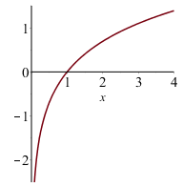
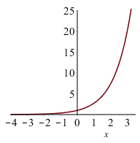
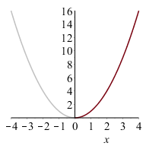
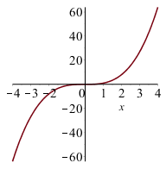
Absolute value is non-negative
Theorem: For any complex number z, |z| ≥ 0.
To prove this, we need a new concept:
A function f is strictly monotonic increasing
f (x) < f (y) whenever x < y
Some examples:
is strictly monotonic increasing for x ≥ 0
ln(x) is strictly monotonic increasing for x > 0
e^{x} is strictly monotonic increasing for all real x
x² is strictly monotonic increasing for x ≥ 0
x³ is strictly monotonic increasing for all real x

Slide 9
Absolute value is non-negative
Theorem: For any complex number z, |z| ≥ 0.
Proof:
If z = α + βj, then α and β are real
Thus, α ² ≥ 0 and β ² ≥ 0 .
Thus, α ² + β ² ≥ 0 .
But the square root is strictly monotonic increasing, so
.
QED

Slide 10
Absolute value is positive definite
Theorem: |z| = 0 if and only if z = 0.
How do we prove a statement that says P if and only if Q
There are four ways of proving this:
Assume P is true, and show that Q is true. Assume Q is true, and show that P is true.
Assume P is true, and show that Q is true. Assume P is false, and show that Q is false.
Assume P is false, and show that Q is false. Assume Q is false, and show that P is false.
Assume Q is true, and show that P is true. Assume Q is false, and show that P is false.

Slide 11
Absolute value is positive definite
Theorem: |z| = 0 if and only if z = 0.
Proof: Assume z = 0 + 0j.
Thus, .
Assume z ≠ 0 + 0j.
Thus, z = α + β j where α ≠ 0 or β ≠ 0.
Thus, either α ² > 0 and β ² ≥ 0, or α ² ≥ 0 and β ² > 0.
– If β ² ≥ 0, α ² + β ² ≥ α ², yet α ² > 0
– If α ² ≥ 0, α ² + β ² ≥ β ², yet β ² > 0
Thus, in either case, α ² + β ² > 0.
But the square root is strictly monotonic increasing
Thus, .
QED

Slide 12
Absolute value is absolutely scalable
To this point, if γ is real and z = α + β j, we have defined γ z
Recall that,
For a real number γ, we have:
Question: Is ?

Slide 13
Absolute value is absolutely scalable
Theorem: |γ z| = |γ| |z|
Proof:
but γ ² ≥ 0
QED

Slide 14
Absolute value is absolutely scalable
A few examples:
If z = 3 + 4 j then |z| = 5
Then –3z = –9 – 12j
Thus, |–3||z| = 3 × 5 = 15
Also,
If w = 0.8 + 1.5j, then |w| = 1.7
Then, 2.5w = 2 + 3.75j
Thus, |2.5||w| = 2.5 × 1.7 = 4.25
Also,

Slide 15
Summary
In this topic, we’ve introduced the absolute value of a complex number
The distance to 0
We defined functions that are strictly monotonic increasing
We saw that:
|z| ≥ 0
|z| = 0 if and only if z = 0
|γ z| = |γ||z| if γ is real
Reminder: we will be seeing other proofs in this course
This is just a taste of how we rigorously prove these theorems

Slide 16
References
[1] https://en.wikipedia.org/wiki/Absolute_value#Complex_numbers

Slide 17
Acknowledgments
None so far.

Slide 18
Colophon
These slides were prepared using the Cambria typeface. Mathematical equations use Times New Roman, and source code is presented using Consolas.
The photographs of flowers and a monarch butter appearing on the title slide and accenting the top of each other slide were taken at the Royal Botanical Gardens in October of 2017 by Douglas Wilhelm Harder. Please see
https://www.rbg.ca/
for more information.

Slide 19
Disclaimer
These slides are provided for the ne 112 Linear algebra for nanotechnology engineering course taught at the University of Waterloo. The material in it reflects the authors’ best judgment in light of the information available to them at the time of preparation. Any reliance on these course slides by any party for any other purpose are the responsibility of such parties. The authors accept no responsibility for damages, if any, suffered by any party as a result of decisions made or actions based on these course slides for any other purpose than that for which it was intended.

